Slide 1
Web Workers
Notes:
Web Workers is a multithreading API in HTML5. It allows a Web page to kick off additional threads to do work in the background, so that the main UI thread remains responsive.

Slide 2
Contents
Overview of HTML5 Web Workers
Using the HTML5 Web Workers API
Demos folder:
Demos\17-WebWorkers
Notes:
Section 1 gives you an overview of the principles of Web Workers in HTML5, and Section 2 explains the API. It's quite a simple API as it happens, so there shouldn't be any great trauma here ☺.

Slide 3
1. Overview of HTML5 Web Workers
Key concepts
Some restrictions
Example scenarios
How Web Workers works
Checking for support
Notes:
Web Workers is an HTML5 API that allows a Web page to start any number of background threads, where background work can happen without blocking the main UI thread in the Web page. This ensures the UI remains responsive to user interactions such as key presses and mouse movements.

Slide 4
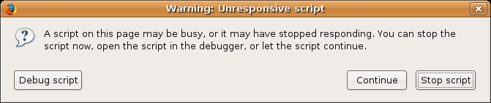
Key Concepts
HTML5 Web Workers bring background processing capabilities to web applications
Run on separate threads, so JavaScript apps using HTML5 Web Workers can take advantage of multi-core CPUs
Separating long-running tasks into HTML5 Web Workers also avoids the "slowscript" warnings
Notes:
Web Workers is a very simple threading API. If you've come from a programming background in C++, C#, Java etc. you'll be quite surprised.
Basically the API allows you to create a new thread and to send data to it. That's it. There are no sophisticated locking mechanisms such as semaphores or latches, no threadpools, no concurrent collections etc. All very simple.

Slide 5
Some Restrictions
Web Workers are powerful, but there are some things they can't do
When a script is executing inside a Web Worker, it can't access the web page’s window object (window.document)
This means Web Workers don’t have direct access to the web page and the DOM API
You overcome this limitation by sending update messages to the main Web page
Notes:
As well as bearing in mind the limitations on the slide, we would also urge you to be sensible! Although Web Workers can't block the browser UI, they can still consume CPU cycles. This could make the system less responsive.

Slide 6
Example Scenarios
Scenario 1:
You want to create a Web app that has to perform some background number crunching
Scenario 2:
A web app could use Web Workers to listen for news messages broadcast from a back-end server
Notes:
Scenario 1
You want to create a Web application that has to perform some background number crunching…
You don't want those tasks to interfere with the interactivity of the Web page itself.
Using Web Workers, you can spawn a Web Worker to perform the tasks.
Typically, you'll also define an event listener to listen to messages from the Web Worker as they are sent.
Scenario 2
A web application could use Web Workers to listen for news messages broadcast from a back-end server…
This Web Worker might use Web Sockets or Server-Sent Events to talk to the back-end server.
Typically, the Web Worker would post messages to the main web page as they are received from the back-end server,

Slide 7
How Web Workers Work ☺
To use Web Workers in a Web page:
Create a Web Worker object, and pass in a JavaScript file to be executed
In the page, set up an event listener to process incoming messages and errors posted by the Web Worker
To communicate from a Web page to a Web Worker, call postMessage() to pass in the required data
To implement a Web Worker:
Create a JavaScript file
In the JavaScript file, set up an event listener to process incoming messages and errors posted by the Web page
To communicate from a Web Worker to a Web page, call postMessage() to pass in the required data
Notes:
If you want a Web page to kick off a background thread, you create a Web Worker object and tell it a JavaScript file to associate with this object. You can then call postMessage() on the Web Worker object. The JavaScript engine will ensure the message is picked up and processed in a background thread by the JavaScript file.
For each kind of task you might want to run in a separate thread, you define a separate JavaScript file. In this file, you handle the message event. The code that you put in the event-handler function will run in its own thread. If you want the thread to communicate back to the main thread, call postMessage().

Slide 8
Checking for Support
You can check whether your browser supports Web Workers
function testForWebWorkers() {
if (typeof(Worker) !== "undefined") {
alert("Your browser supports Web Workers.");
}
else {
alert("Sorry pal, your browser doesn't support Web Workers.");
}
}
Notes:
This slide shows how you can detect if your browser supports Web Workers. If your browser doesn't support Web Workers, you'll have to do all your processing on the main UI thread (or dispatch work to the server via Ajax, perhaps).

Slide 9
2. Using the HTML5 Web Workers API
Creating Web Workers
Setting up event handlers
Communicating with Web Workers
Stopping Web Workers
Implementing a Web Worker
Loading and executing additional JavaScript
Additional techniques
Examples
Notes:
This section takes a detailed look at the API for implementing multithreading using HTML5 Web Workers.

Slide 10
Creating Web Workers
Web Workers are Worker JavaScript objects
When you create a Worker object, you must specify the URL of the JavaScript file
The code in the JavaScript file will run in a separate thread
The URL can be relative or absolute
If relative, it will assume the same scheme, host, and port as the main page
var aWorker = new Worker("MyWorker.js");
Notes:
The first step is to create a Worker object, and specify the JavaScript file that contains the code you want to run in a separate thread.

Slide 11
Setting up Event Handlers
Before you tell the Web worker to do anything, you should set up two event handlers on the Web worker…
message event
Will handle messages posted back from the worker (e.g. results)
error event
Will handle an errors that occur (e.g. script-loading errors)
aWorker.addEventListener("message", myMessageHandler, true);
…
function myMessageHandler(e) {
alert("Worker response data: " + e.data);
}
aWorker.addEventListener("error", myErrorHandler, true);
…
function myErrorHandler(e) {
alert("Error [" + e.filename + ", line " + e.lineno + "] " + e.message);
}
Notes:
Before you dispatch any work to the background thread, you probably want to handle the possibility that the background thread might send you back some results during its operation. To do this, handle the message event on the Web Worker object as shown in the upper code box in the slide.
You should also handle the possibility that the background thread might cause an error. To do this, handle the error event as shown in the lower code box in the slide.

Slide 12
Communicating with a Web Worker
To communicate from a Web page to a Web Worker:
Call postMessage() to pass in the required data
Example 1
Posting a simple string message:
Example 2
Posting a JavaScript object (e.g. a person) as a message:
aWorker.postMessage("Here's some data for the Web Worker to use");
aWorker.postMessage({ 'name': 'Andy',
'age': 21,
'welsh': true });
Notes:
To send data to a Web Worker, call the postMessage() method on the Web Worker object. You can either pass a simple string, or a JavaScript object in JSON format.

Slide 13
Stopping Web Workers
Web Workers don’t stop by themselves, but the page that started them can stop them
E.g. to reclaim resources when a Web Worker has notified the Web page that it has finished its tasks
E.g. to cancel a long-running task, in response to user intervention
To stop a Web Worker:
Call terminate() on the Worker object
aWorker.terminate();
Notes:
You can terminate a background thread whenever you like, via the terminate() method as shown in the slide.

Slide 14
Implementing a Web Worker
A Web Worker can listen for incoming messages sent from the Web page:
Define an event listener to listen for message events
A Web Worker can communicate back to a Web page:
Call postMessage() to pass in the required data
You can pass anything (e.g. a string or a JavaScript object)
addEventListener("message", myWorkerMessageHandler, true);
…
function myWorkerMessageHandler(e) {
// Access message from main page via e.data.
// E.g. e.data accesses the whole message object.
// E.g. e.data.name, e.data.age, e.data.welsh accesses parts of the message object.
}
postMessage("Here's some data for the Web page to display");
Notes:
Let's now switch our attention to the code in the JavaScript file, which will execute in a different thread. To handle messages posted from the main thread, you must handle the message event on the window object, as shown in the upper code box in the slide.
You can also send data back to the main thread at any time, by calling postMessage() on the window object, as shown in the lower code box in the slide.

Slide 15
Loading and Executing Additional JS
Web pages import JavaScript files via <script> tags
The <script> tags load JS files synchronously, as the page loads
However, Web Workers don't have access to the document object
So Web Workers can't use <script> tags to load JS files
Instead, they can call the importScripts() function
Loads and executes JS files synchronously, into the existing worker
importScripts("MyHelper1.js", "MyHelper2.js");
Notes:
If your JavaScript file wishes to include other JavaScript files, this is fine. You must call importScripts() as shown in the code snippet in the slide.

Slide 16
Additional Techniques
A Web Worker can create sub-workers:
HTML5 Web Workers can't access the window object, but they can use the JavaScript timing API
var subWorker = new Worker("MySubWorker.js");
var t = setTimeout(postMessage, 2000, "Delayed message to main page");
Notes:
A common question is whether a background thread can kick off other background threads. The answer is "yes" - see the upper code box in the slide.
Note that a background thread cannot communicate directly with the main window object (for reasons of thread safety). However, you are allowed to call the following methods:
setTimeout()
setInterval()
clearTimeout()
clearInterval()

Slide 17
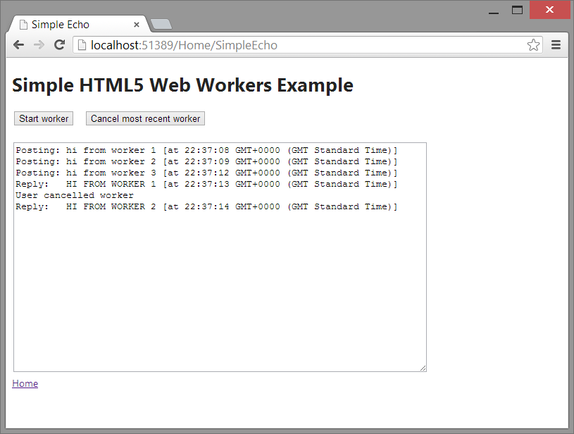
Example: Passing String Parameters
Open the demo project in Visual Studio
Run the app, and click the Simple Echo Demo link
Notes:
This demo shows a complete example of Web Workers. It shows a Web page that exchanges simple string messages with a background thread.

Slide 18
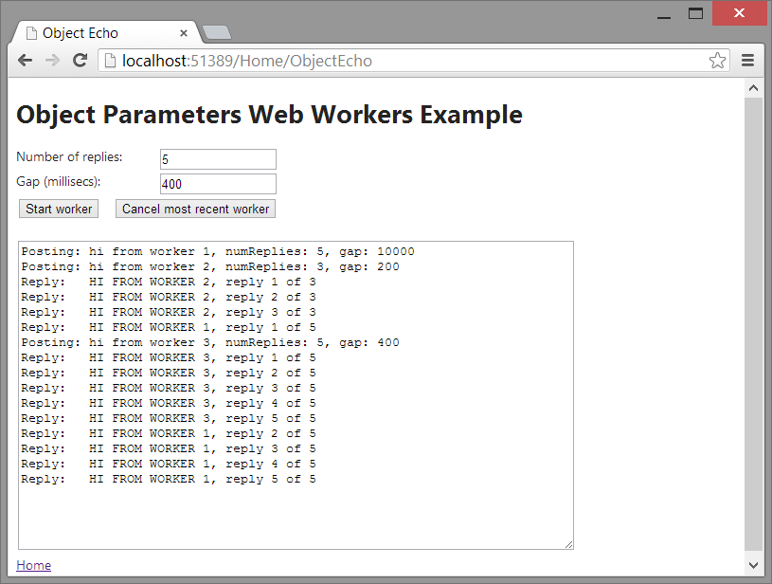
Example: Passing Object Parameters
Open the demo project in Visual Studio
Run the app, and click the Object Echo Demo link
Notes:
This part of the demo shows a Web page that exchanges JavaScript objects (via JSON) with a background thread.

Slide 19
Any Questions?

